Slide 1
Fat-Soluble Vitamins
Vitamins A, D, E and K.
Require bile and dietary fat for absorption.
Once absorbed, they are transported with fats through the lymphatic system in chylomicrons before entering the blood.
Fat-soluble vitamins can be stored in body fat, hence these vitamins are not easily excreted. This increases the risk of toxicity with high intakes.

Slide 2
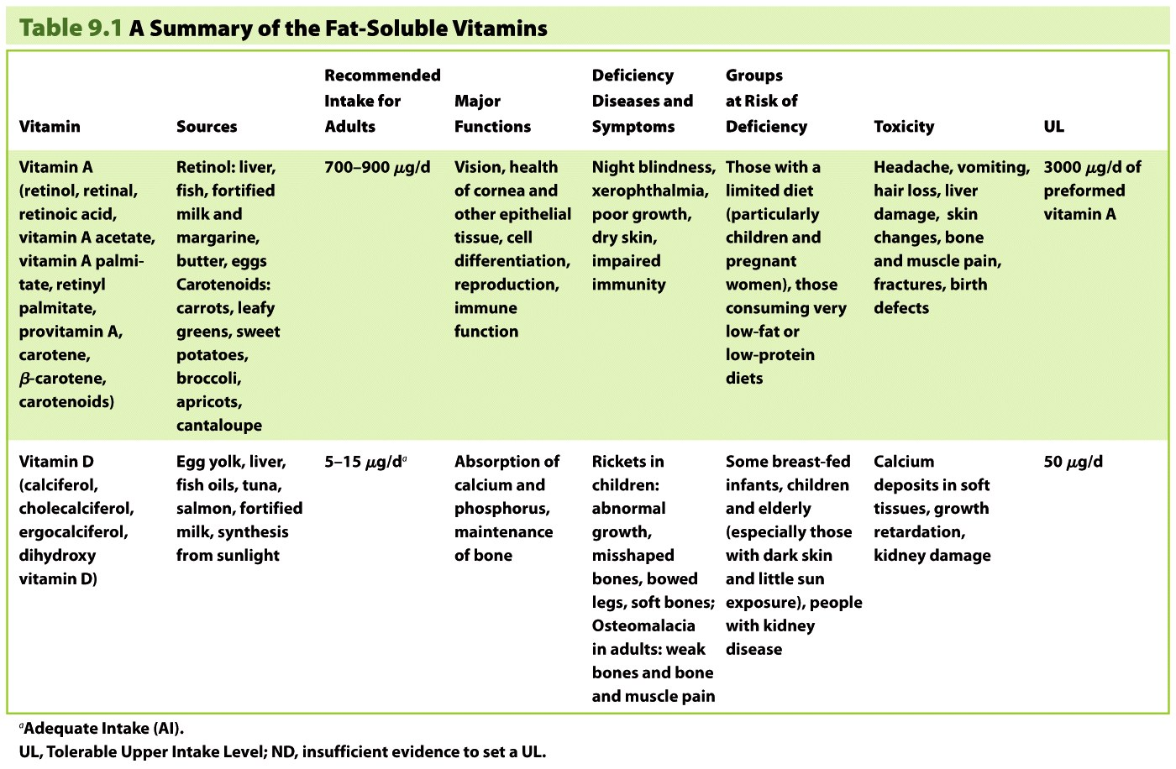

Slide 3
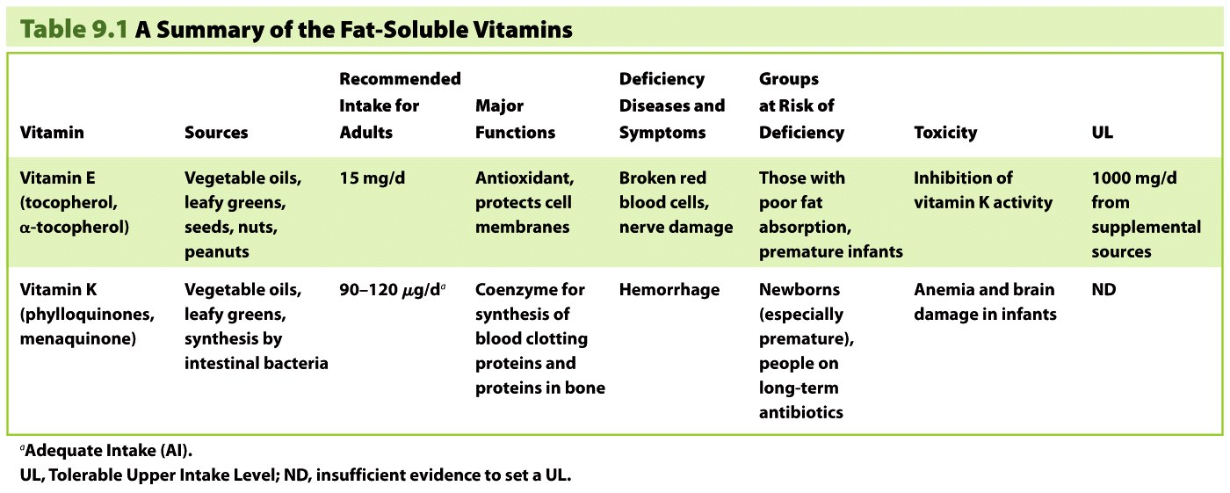

Slide 4
Vitamin K deficiency
The most likely deficiency is due to inadequate vitamin reserve of the newborn.
The low levels of vit K begin to rise by 4 - 7 day of birth.
Injecting vit. K 1- 2 mg shortly after birth.
Nizel AE. Papas AS.Nutrition in clinical dentistry; 3rd edition

Slide 5
MACROMINERALS
Minerals are available in unprocessed foods, some processed foods and dietary supplements.
To maintain health, minerals must be consumed in the correct proportions.
Bioavailability is very important. For example, phytates can limit the body’s ability to absorb calcium, zinc and iron.
Because certain minerals can be toxic if taken in too high an amount, ULs have been established.

Slide 6
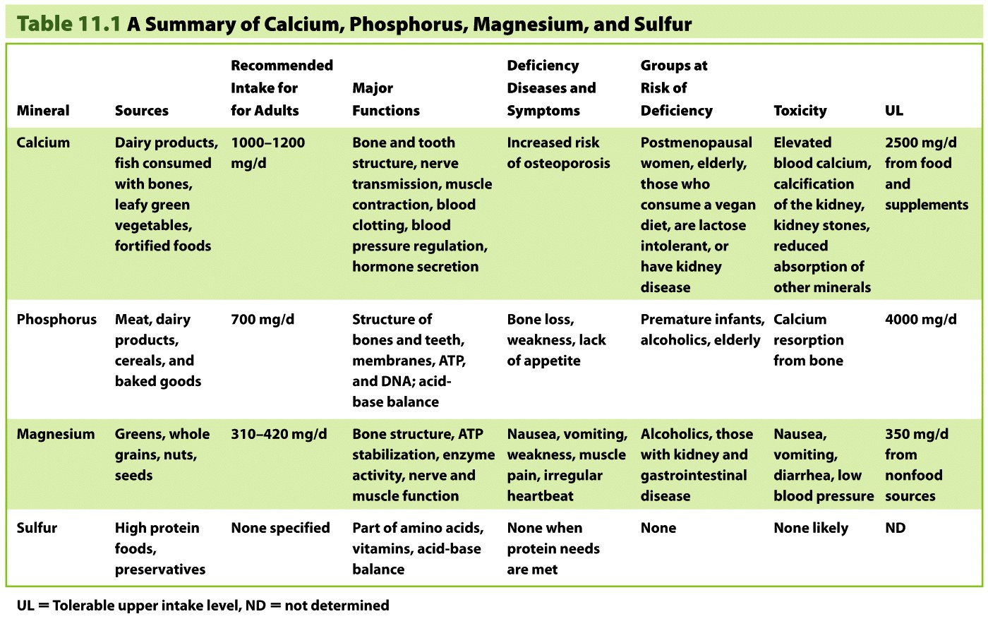

Slide 7
CALCIUM
CALCIUM
1%
ECF+ soft tissue
99%
HA+TCP
RDA :
BELOW 1 YR : 360 – 540 mg
1 – 10 YR : 800 mg
11 – 18 YR : 1200 mg
Nizel AE. Papas AS.Nutrition in clinical dentistry; 3rd edition

Slide 8
bone & teeth: growth & mineralization
Enamel:
Mineralization and matrix formation continues simultaneouslyfrom the beginning of enamel development by ameloblasts.
Mineral content – 95-97%.
Major protein fraction – phosphoproteins.
Nizel AE. Papas AS.Nutrition in clinical dentistry; 3rd edition

Slide 9
P in oral health:
Papas et al (1964) – phosphates – cariostatic.
Different cations combined with orthophosphates were ranked from most cariostatic to least as :
Different phosphate ions combined with same cation were ranked from most cariostatic to least as:
Conclusion : sodium trimetaphosphate – reduced caries – 80 – 90%
Na ⁺
K ⁺
Ca ⁺
Tripoly
Hexameta
Ortho
Pyro
Trimeta
Nizel AE. Papas AS.Nutrition in clinical dentistry; 3rd edition

Slide 11
Magnesium and oral health
Present in both enamel & dentin (1:2)
In rats:
Hypoplastic teeth
Degenerative changes in ameloblasts and odontoblasts.
Reduced rate of alveolar bone formation
PDL widening
Gingival hyperplasia
Periodontal destruction.
Navia et al – excess of Mg – increased caries development in rats.
Nizel AE. Papas AS.Nutrition in clinical dentistry; 3rd edition

Slide 12
TRACE MINERALS
The trace elements include iron, zinc, copper, manganese, selenium, iodine, fluoride, chromium and molybdenum.
They are required in amounts less than 100 mg per day.
Present adequately in a mixed diet.
Can be toxic at a small increase over RDA.
Trace elements have been difficult to study, as they are difficult to remove from the diet.

Slide 13
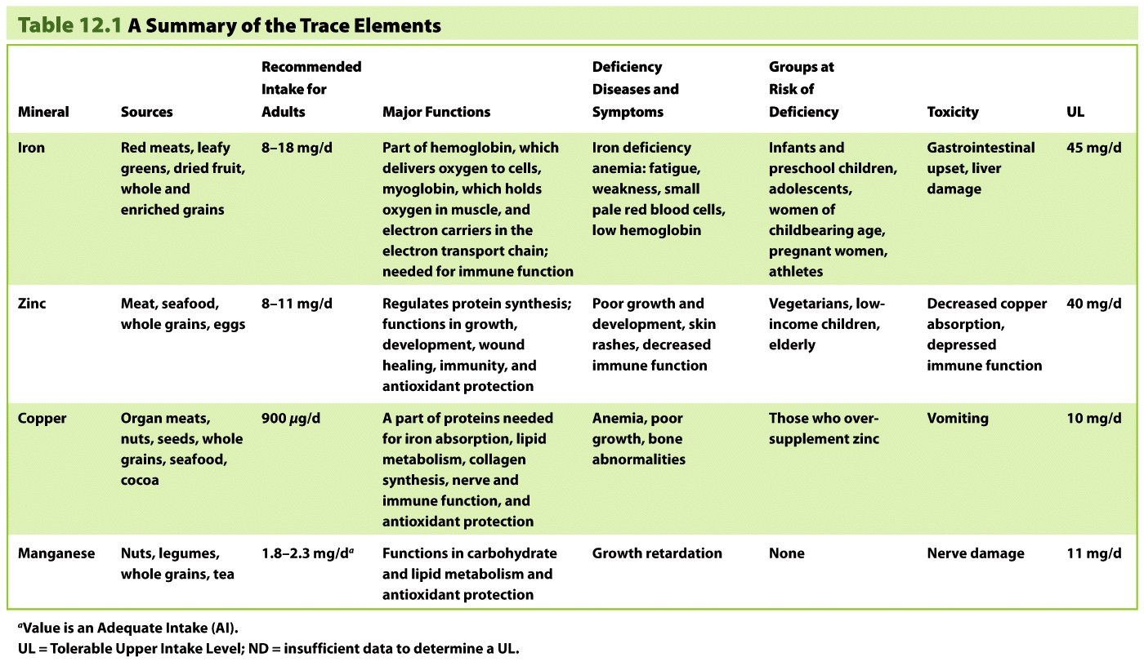

Slide 14
Iron in oral health
Iron deficiency anemia –
Weakness, fatigue, pallor, numbness and tingling of extremities, dull and brittle nails, koilonychia.
Oral manifestation –
Atrophic Glossitis,
Atrophy of papillae making the tongue appear smooth, shiny and red.
OMM – atrophic and ashen grey.
Angular stomatitis,
Dysphagia
Plummer vinson syndrome
Nizel AE. Papas AS.Nutrition in clinical dentistry; 3rd edition

Slide 16
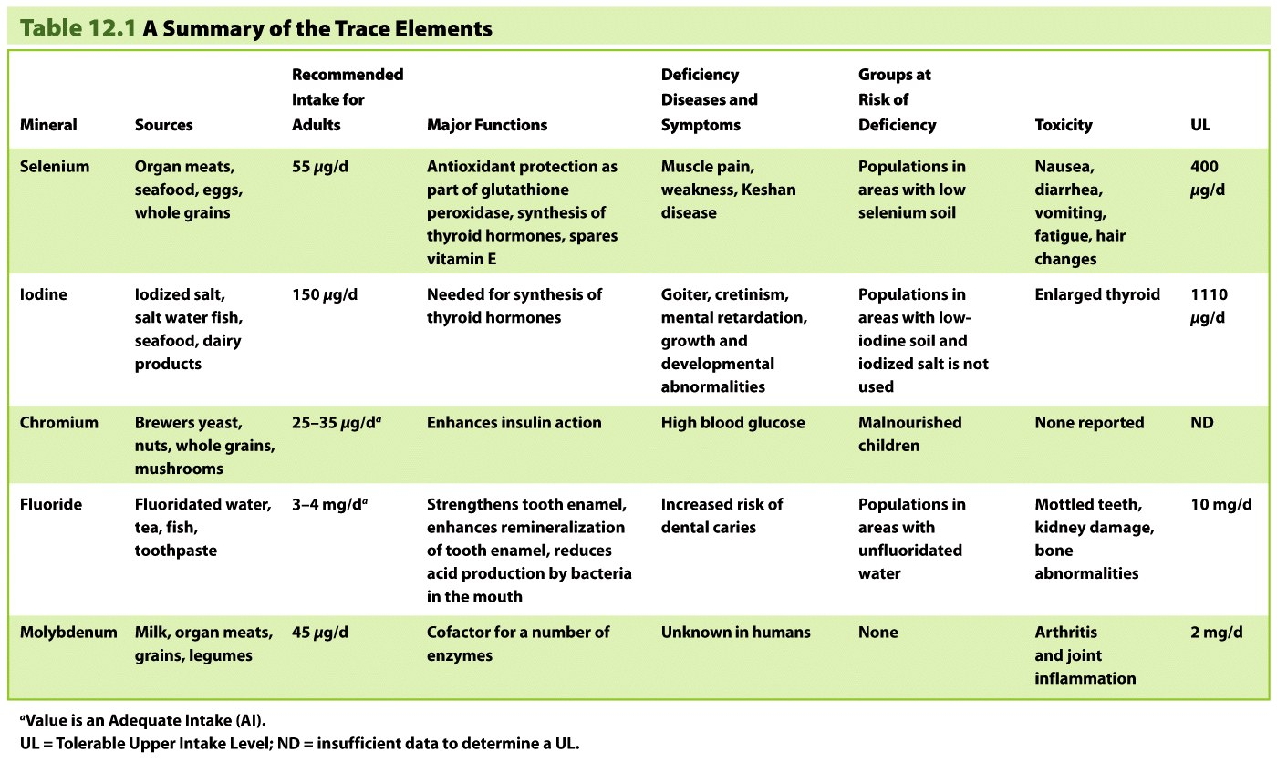

Slide 17
minerals and caries
Caries promoting
Selenium
Mildly cariostatic
Molybdenum
Vanadium
Caries inert
Ba
Cadmium
Platinum
Magnesium
Lead
Silicon
Strontium
Calcium
Boron
Gold
Al
Ni
Fe
Ti
Strongly cariostatic
Fluoride
Phosphorus
Nizel AE. Papas AS.Nutrition in clinical dentistry; 3rd edition

Slide 18
DIET COUNSELLING
Burnard defines counseling as the means by which one person helps another to clarify his/her life situation and to decide on further lines of action.
Diet counseling involves constant interaction between the counselor and the clients/patients about therapeutic diets to produce a change in food behaviour.
It is recommended, that dietary counseling in dental diseases should be comprehensive for the whole human health and not just for any particular dental disease.
African Journal of oral Health;2006:2(1):26-36.

Slide 19
Health risk :
Over – weight.
Children withdraw from social and physical activities.
Dental – permanent teeth eruption.
Dietary control is necessary.
Goran koch, Pediatric dentistry, 1st edition

Slide 20
Objectives of diet counselling:
To direct the attention towards the influence of diet on dental health and diseases.
To help modify food selection patterns for better dental and general health.
Direct attention towards environmental influence on dietary habits.
Facilitate healthy choices.
Goran koch, Pediatric dentistry, 1st edition

Slide 21
Following facts should be stressed:
Frequent sugar intake should be restricted since it is the most important caries inducing factor.
Sweets should be taken during the meals.
Brush the teeth immediately after eating or rinse, swish and swallow. Don’t allow the debris to stay in the mouth.
Always brush at bed time.
The long term goal is to starve the starve the acid producing bacteria of the oral cavity.
Any diet counselling should be followed up during the course of treatment to evaluate the outcome and reinforce positive results.
Goran koch, Pediatric dentistry, 1st edition

Slide 22
Take Away Home Message
A balanced diet is one in which nutrients from each food group in recommended servings is present for the optimal functioning of the human body.
Vegetables and fruits are important because they contribute vitamin A and C and fiber as well as trace amount of other nutrients.
Meat are valued for protein ,phosphorus,niacin,vitamin B12 and iron.
Eat a minimum to moderate amount of sugar.
Achieve and maintain ideal weight.

Slide 23
References
Nizel AE.Papas AS.Nutrition in clinical dentistry; 3rd edition.W B saunders.
Mc donald.Avery.Dean. Dentistry for the child adolescent. Nutritional Consideration for the pediatric Dental patient. 8th edition.
Goran koch. Pediatric dentistry, 1st edition
Ernest newburn; Cariology; 3rd edition
Smolin & grosvenor. Nutrition science & applications; 2nd edition

